Slide 1

Chapter 7
The Role of Career Information and Technological Resources in Career Planning

Slide 2
Learning Objectives
1. Explain the role of career information and technological resources in career planning.
2. Define career information and its use.
3. Describe the role of the career services provider with respect to using information and technological resources in the career planning process.
4. Identify and describe multiple types and sources of information, including career information and technological resources.
5. Explain how information is culture specific.
6. Critically evaluate career information and technological literacy.

Slide 3
Learning Objectives
7. Incorporate information and technology into the career planning process.
8. Explain unique opportunities and challenges presented by technological resources.
9. Identify the elements required for providing online career services.
10. Evaluate the technology readiness of yourself and clients.
11. Explain how career information and technology resources can be used to help a client with their career goals.
12. Create a plan for staying current with career information and technology resources.

Slide 4
The Role of Information and
Technological Resources
Ultimately the role of information and technological resources in career planning is to provide the career seeker with additional data to include in his/her decision-making.
The goal of this chapter is to broaden your ability to identify, evaluate, and apply various information resources to common career problems faced by your clients.

Slide 5
Career Information:
Definition and Uses
Information can be defined as data, knowledge, or intelligence that is either given or received.
May be:
    fact or opinion
    valid or invalid
    simple or complex
    current or outdated
    presented in or out of context
    useful or not useful
Career information - specific to occupations or the career development process.
Career information can be used creatively to help clients with their career decisions.

Slide 6
Roles and Responsibilities of
Career Services Providers
Using information means:
  Being aware of international, national, state, and local career information sources, including legislation about employment
  Using the mode for accessing information that clients prefer.
  Evaluating and determining that information being used is current, valid, and free from bias.
  Sequencing the use of information in a way that makes sense and does not overwhelm clients.

Slide 7
Roles and Responsibilities of
Career Services Providers
Using technology to access information includes:
Determining clients’ readiness to use the Internet.
Understanding how to evaluate online and technological resources for quality, including privacy and confidentiality.
Having a knowledge of which technological tools will best meet clients’ needs

Slide 8
Assessing Client Readiness to Use Technology
Main consideration would be client experience and comfort with technology.
Another possible problem is the impact of negative thinking on using career information.

Slide 9
Types of Information
• Written materials
• Verbal interactions with someone in the field
• Experiential activities
• Visual and auditory presentations
• Web-based tools
• Career information delivery systems

Slide 10
Classification Systems
The purpose of classification is to organize information so that it can be easily accessed by a variety of individuals for different purposes. Some classification systems that are of use to career services providers
Holland RIASEC Classification System
Standard Occupational Classification (SOC) system
North American Industry Classification System (NAICS)
International Standard Classification of Occupations (ISCO)
National Career Clusters

Slide 11
What Affects the Labor Market?
The labor market is a dynamic relationship between employers and employees; it can be affected by many trends and changes.
From the employer’s perspective:
  Constant advance of technology creates new jobs and causes others to become obsolete.
  Stockholders and/or executives may apply pressure for more profit or cost-containment
  Growth or decline in the economy
  Sending work to places in the world where lower wages are paid
  Choosing to subcontract work out
  Federal regulations regarding imports from other countries
  Too few skilled workers available to employ in increasingly technological worksites.

Slide 12
What Affects the Labor Market?
From the employee’s perspective:
  Growth of industries and sectors that create jobs
  Laws that protect workers’ rights
  Employers not converting equipment to meet changing technological opportunities
  Legislation designed to protect and give equal rights to members of the diverse populations that make up the U.S. workforce
  The rate at which the United States issues work permits and visas to new immigrants
  Changes in technology that make current job skills obsolete and require upgrading or replacing of skills
  Modification of legislation or practices impacting retirement age

Slide 13

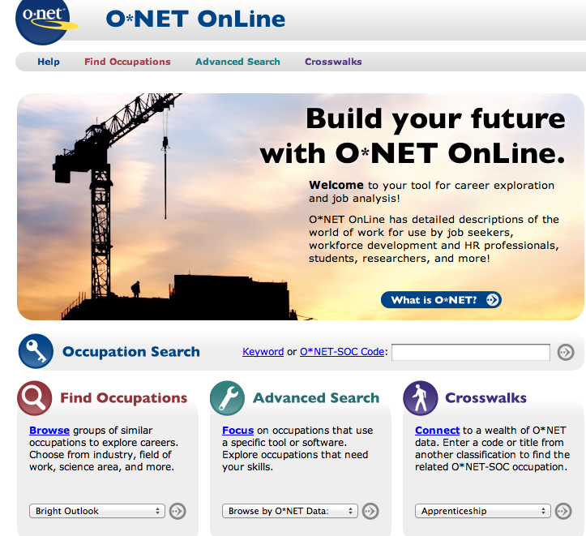

Common Career Information Sources
O*NET
Occupational Outlook Handbook
My Next Move
Career One-Stop
Notes:
These are linked to the Internet so that the instructor can show live demonstrations of what is contained in each.

Slide 14
Social Networking Sites (SNS) and Other Online Tools
Career services providers can help individuals wanting to use SNS in their job search by:
Helping individuals understand that using social networking is just one aspect of the job search process.
Providing articles about how to use SNS effectively.
Discussing how to use SNS to research companies of interest or join relevant professional groups.
Giving tips on how to create and market an effective online profile or presence.
Reviewing privacy issues associated with being in online SNS groups.

Slide 15
Online tools
Blogs: A blog (short for weblog) is similar to an online diary.
Podcasts: A “program made available in digital format for automatic download over the Internet”.
Wikis: In common language today, wiki has come to refer to a webpage to which multiple people can add content
Discussion Boards: A discussion board or group is a website that allows individuals to “discuss” various topics.
Mobile apps are growing in popularity and many of your clients may be interested in a mobile version of career information resources.

Slide 16
Career Information Literacy
Can you:
Recognize when information is needed?
Locate information that you or your clients need?
Critically evaluate information to determine its quality, currency, and accuracy?
Effectively use the needed information?

Slide 17
Critically Evaluating Information and Technological Resources
Accurate: The descriptions of options (jobs, occupations, schools, majors) must be accurate so that the information is useful
Understandable: Descriptions of options must be in words understandable and at an appropriate reading level to the given audience.
Current: Databases need to be updated frequently so that they are accurate.
Specific: Career information must be realistic and provide appropriate details.
Sufficient: The description provided must contain enough essential information
Unbiased: The information should not come from a source that would have a reason to want to make it look worse or better than it really is.

Slide 18
Incorporating Information/Technology Into Career Planning
Information is a foundational tool that all career professionals use to help their clients make career decisions. It can be ised at every stage in the process.
  Self-assessment
  Researching options
  Making a decision (pro/con analyses)
  Job search
The chapter gives an example of integrating information into the CASVE Cycle

Slide 19
Technological Resources:
Benefits
Some benefits include:
  expediency
  currency
  convenience
  24/7 availability/service
  access to multiple sources of information
  lower expense
  ability to address different learning styles

Slide 20
Technological Resources:
Challenges
Some potential challenges of online tools include:
  The skill levels of both the client and the career services provider.
  The “digital divide”
  Maintaining privacy and confidentiality
  Quality of resources

Slide 21
Online Service Delivery
Various issues to consider
Additional training may be necessary
Possibilities include:
  Completely online services
  Website as a storehouse for information and/or interaction
  Interacting via e-mail, online chat, telephone
Check out NCDA guidelines!!!

Slide 22
Evaluating Technological Readiness
It’s not just for our clients!
Complete the table in the text
What areas are your strengths? weaknesses?
What is your plan for improvement?

